Slide 1


Slide 2



Amelia McNally
Recruitment officer

Slide 3
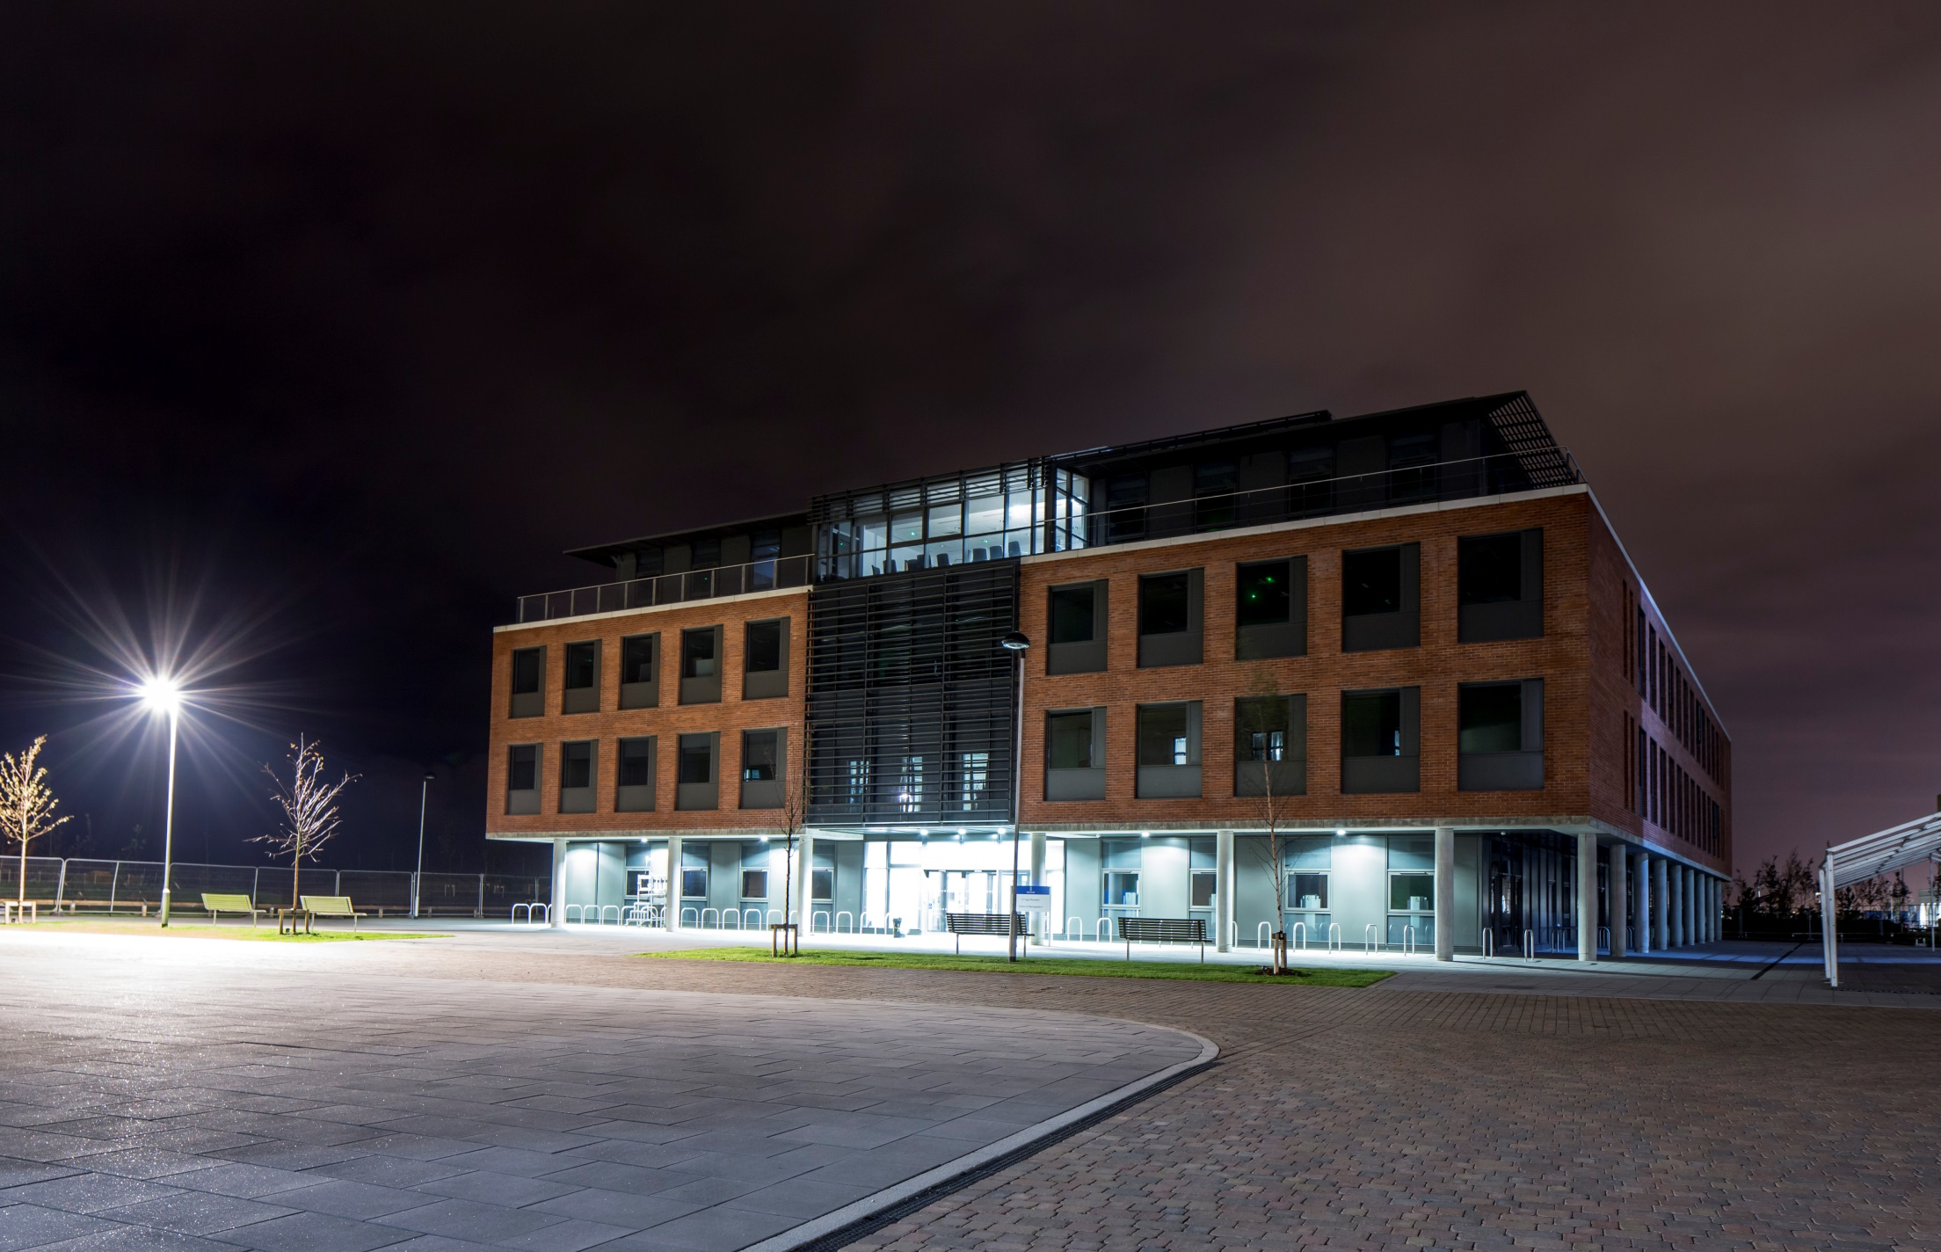
Business Management
Accounting & Finance
Economics

Slide 4
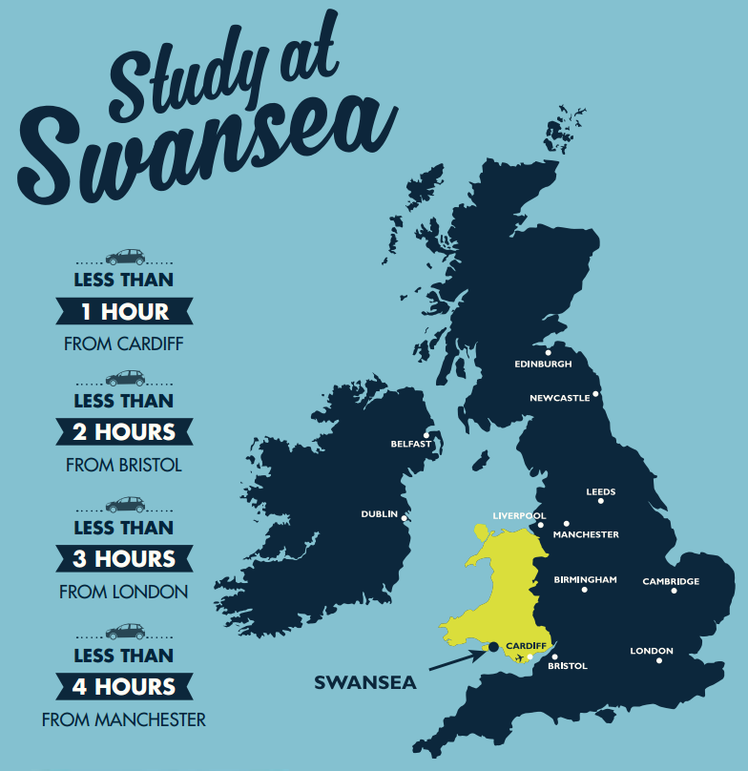
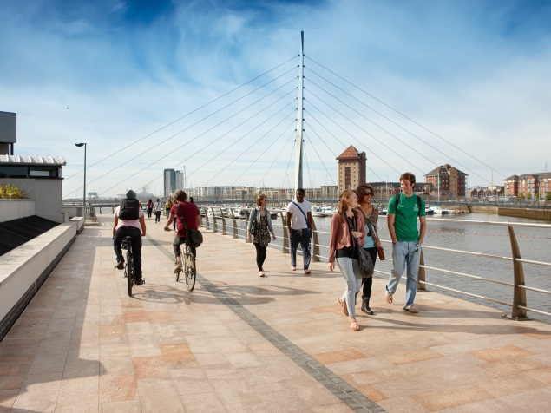
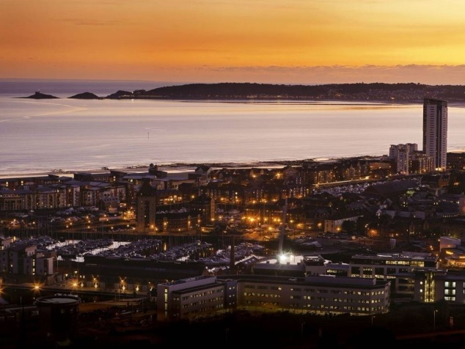
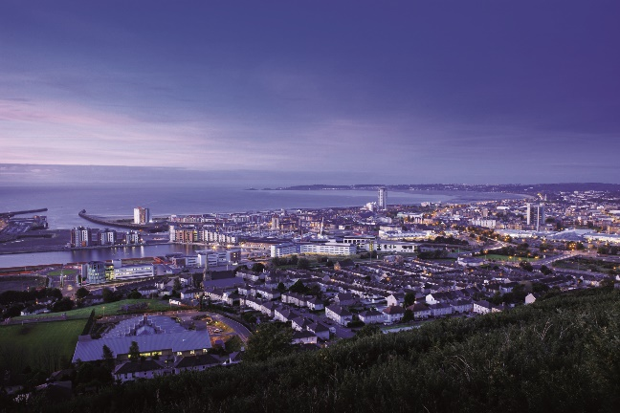



Slide 5

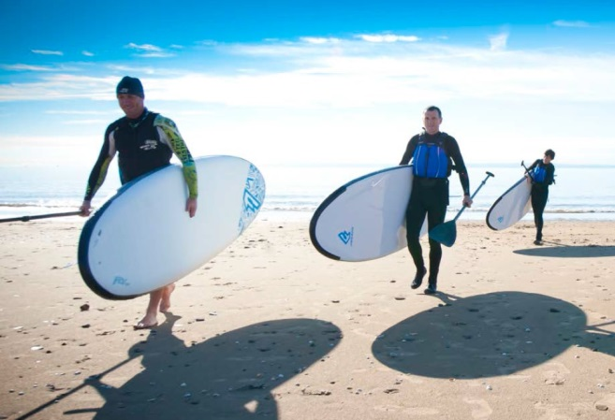

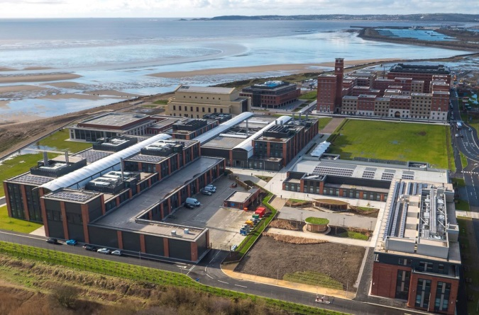
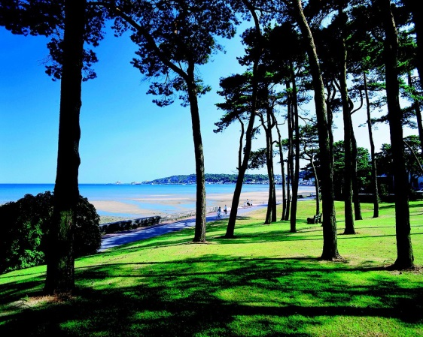


Slide 6




Slide 7

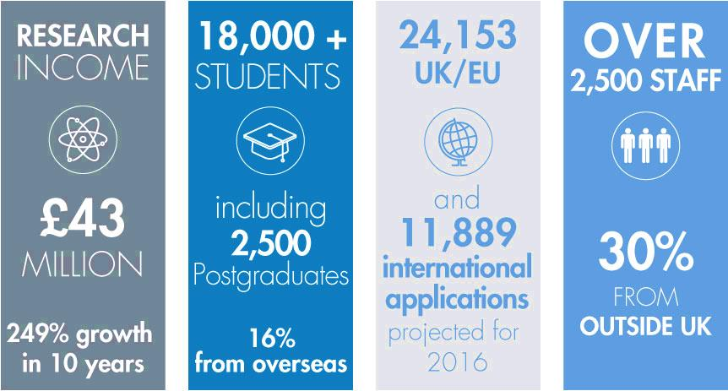


Slide 8

School of Management Profile 2015-16
1700 undergraduate students
400 postgraduate students
International student population from over 50 countries
100+ Academic/teaching staff
60+ Support staff

Slide 9
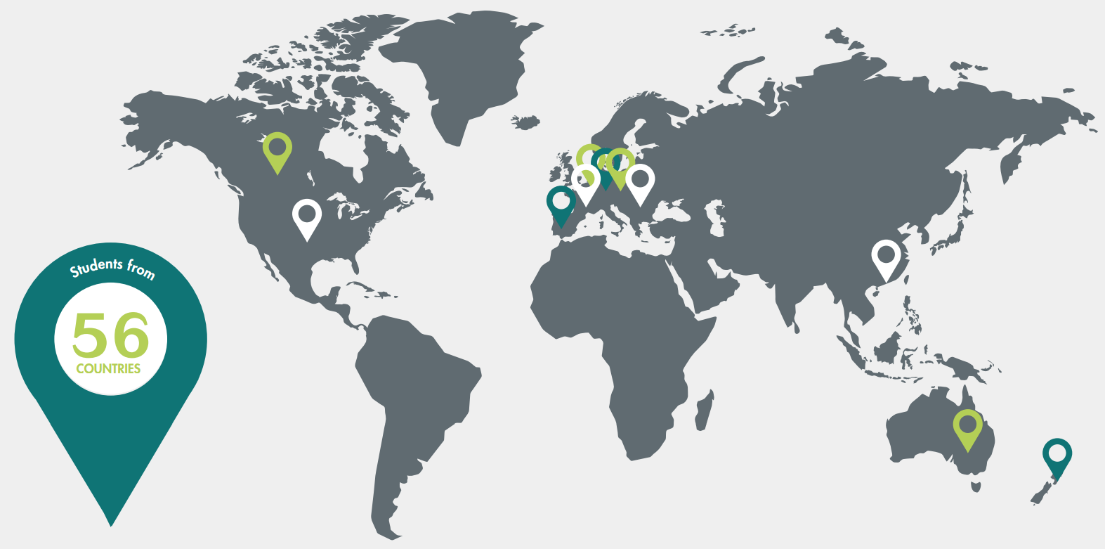
International

Slide 10




Slide 11

The Research Excellence Framework (REF) 2014 ranks Business and Management at Swansea as 30th in the UK for overall research quality.
The REF assesses the quality of research in the UK Higher Education sector, assuring us of the standards we strive for.
Research pioneered at the School of Management harnesses the expertise of academic staff within the department.

Slide 12
REF 2014 shows that 72% of research produced by our academic staff is of
World-Leading (4*) or Internationally Excellent (3*) quality.
Research ‘Impact’ ranked 16th in the UK.
REF Impact defined as ‘an effect on, change or benefit to the economy, society, culture, public policy or services, health, the environment or quality of life, beyond academia’.

Slide 13

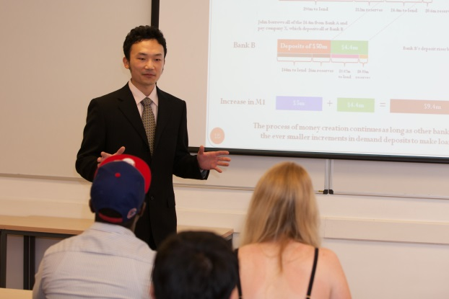
Benefits of Research in Relation to
School of Management Programmes
Teaching by staff with world-leading expertise
Final year projects link with industry collaboration
Access to world-leading research resources
Good potential for further research study

Slide 14
5
ways to enhance your career
with a degree from the School of Management
Study with a world-class faculty at a Top 30 UK Business School
Take your first steps on the career ladder with our flexible and innovative programmes
Use our in-house careers team to maximise your potential
Study at the new £450 million Bay Campus
Gain professional accreditation and interact with industry leaders

Slide 15
Our Undergraduate Courses
Accounting and Finance
BSc Accounting & Finance
BSc Accounting
BSc Finance
Business Management
BSc Business Management
BSc Business Mgt (Marketing)
BSc Business Mgt (Entrepreneurship)
BSc Business Mgt (Operations & Supply)
BSc Business Mgt (Finance)
BSc Business Mgt (Business Analytics)
BSc Business Mgt (e-Business)
BSc Business Mgt (Human Resource)
BSc Business Mgt (Management Consulting)
BSc Marketing
Economics
BSc Economics
BSc Economics & Business
BSc Economics & Finance

Slide 16
Our Postgraduate Courses (12 months – October to September)
Accounting and Finance (Conversion)
MSc Accounting & Finance
MSc Financial Management
MSc Finance & Business Analytics
Accounting and Finance (Specialist)
MSc Finance
MSc International Banking & Finance
MSc Investment Management
Management (& Pathways)
MSc Business Management
MSc Business Mgt (Marketing)
MSc Business Mgt (Finance)
MSc Business Mgt (Human Resource Management)
MSc Business Mgt (Entrepreneurship)
MSc Business Mgt (Operations & Supply)
MSc Business Mgt (International Management)
MSc Business Mgt (International Standards)
MSc Business Mgt (Business Analytics)
MSc Business Mgt (e-Business)
MSc strategic Management

Slide 17
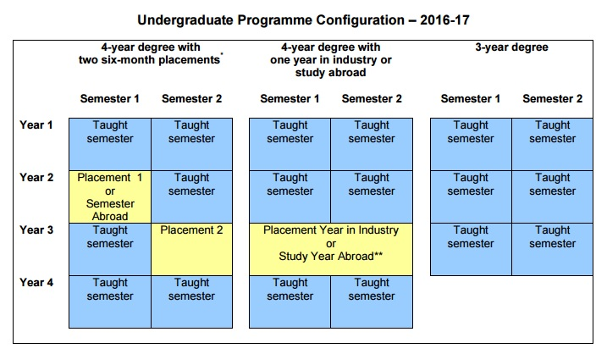

Slide 18

Undergraduate Course Structure
Flexible modular structure
Compulsory 1st year modules
Module options in years 2 and 3 in addition to compulsory elements
Minimum 12 hours taught contact per week
Assessment typically consists of coursework and exam based methods
Feedback on performance given within 3 weeks of deadline

Slide 19
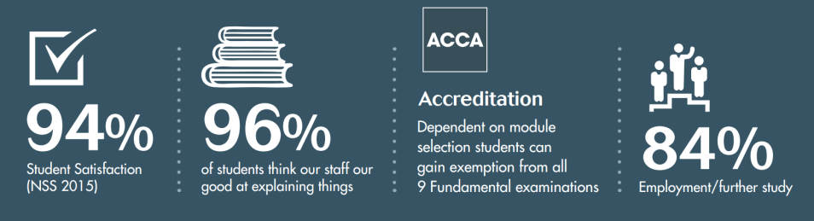
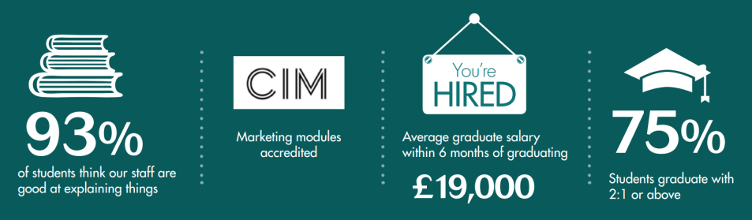

Accounting and Finance
Business Management
Economics

Slide 20

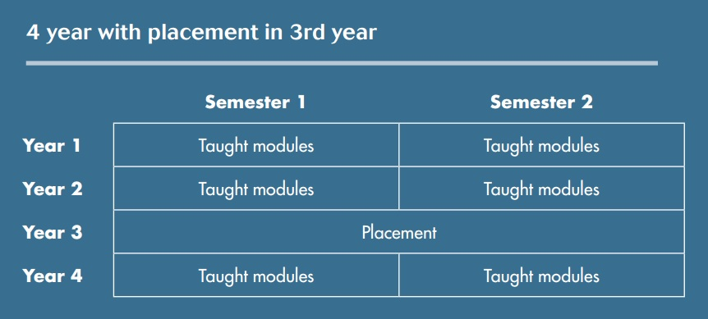
Placement Degrees
The School of Management has a dedicated placements and employability team which facilitates the placements process in-house and advertises a range of potential placement opportunities to students.

Slide 21








Placement Degrees
Some of the confirmed student placements for 2016-17:

Slide 22
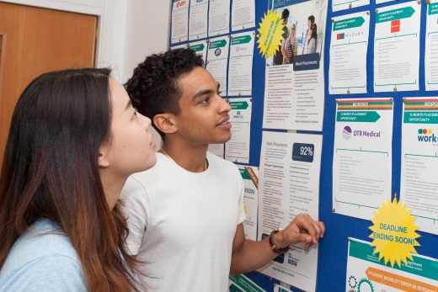

Why choose a placement programme?
Discover what work is like in your chosen field of study
Develop new work-orientated skills
Build confidence and maturity
Gain relevant experience in a real organisation
Gain a breadth of subject knowledge before your final year studies
Help identify your ideal career pathway
Provide you with high level work experience to add to your CV
Translate your academic studies into the real world
Many placements offer competitive salaries

Slide 23
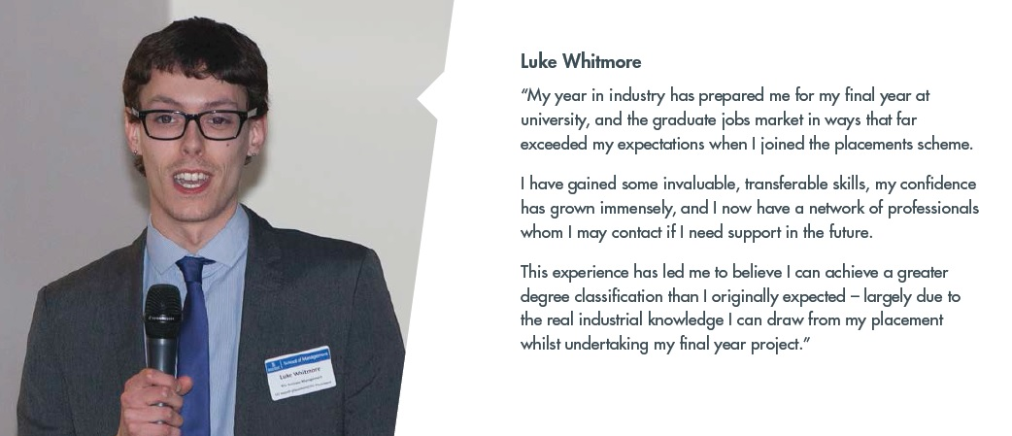

Slide 24

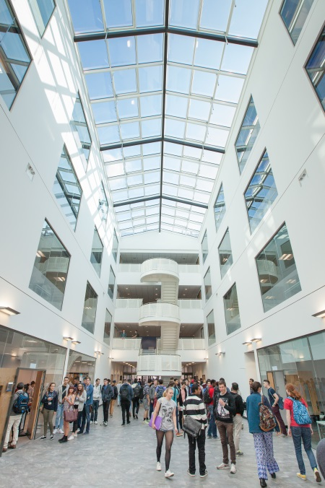
Scholarships
School of Management Developing Futures Scholarships:
Undergraduate £2000 (available to non-EU students)
Postgraduate £3000 (available to all students)

Slide 25
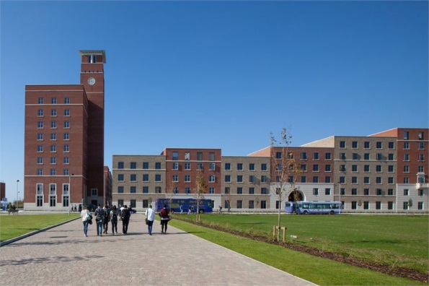

Bay Campus
Swansea University is now a dual-campus university.
There are a full range of recreational, social, eating and
drinking facilities at the Bay Campus including:
  Catering provision – cafes, coffee shops and dining hall
  Student support services
  Mini market, launderette, cash points
  Retail units
  Beach access and outdoor recreational space

Slide 26
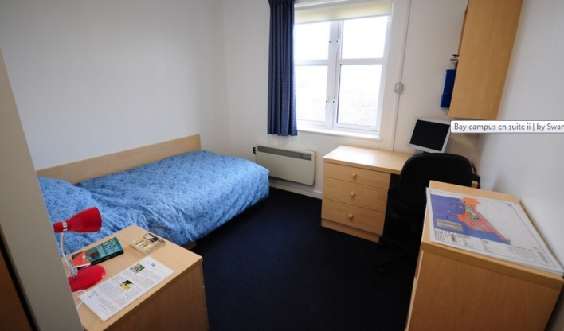
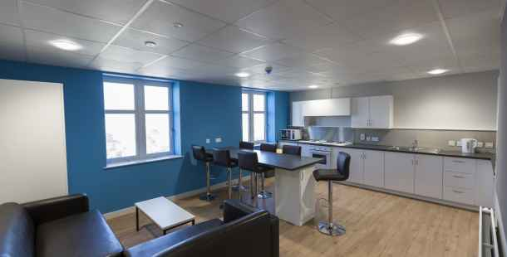
Bay Campus Accommodation
The 1500 en-suite student residences are built
Around internal courtyards, with social spaces and kitchen and catering facilities.
All are en-suite and self-catered, with some single
occupancy apartments available.

Slide 27

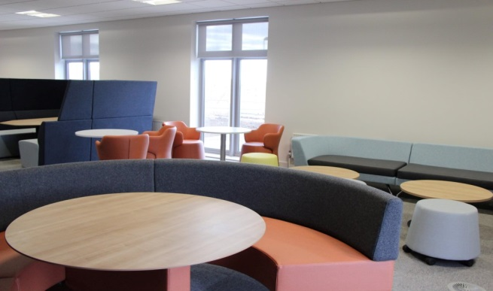
Bay Campus Library
The Bay Library is where you are able to find social learning, research and academic spaces all supporting the work of our undergraduate and postgraduate students and staff.
It provides access to our full range of online journals, e-books, datasets and also to our 850,000 print items.
Open 24 hours a day, 7 days a week.

Slide 28

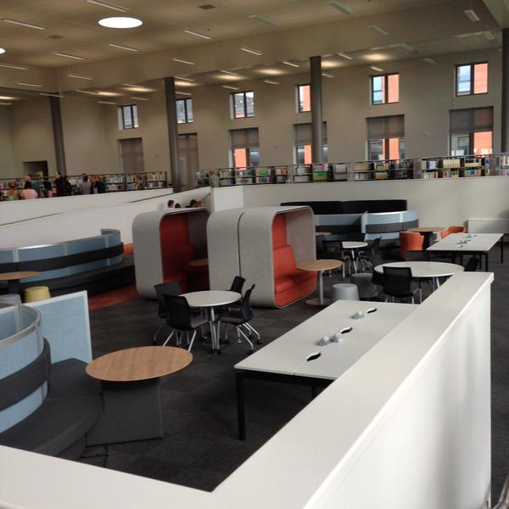
Bay Campus Library
Space for over 650 students
Postgraduate study and computer rooms
Zoned silent study areas for 150 students
A large computing and teaching room
Group study rooms
Cafe
One-to-one interview rooms
A helpdesk covering library, academic support, employability and computing

Slide 29

Bay Campus – The Great Hall
The iconic Great Hall is the most prominent building and feature of the campus.
The Hall is located at the centre of the Bay Campus and provides a beautiful space for the University to host music concerts, conferences, and hold graduation and other large University events. It is available for staff, students and the community to enjoy.

Slide 30
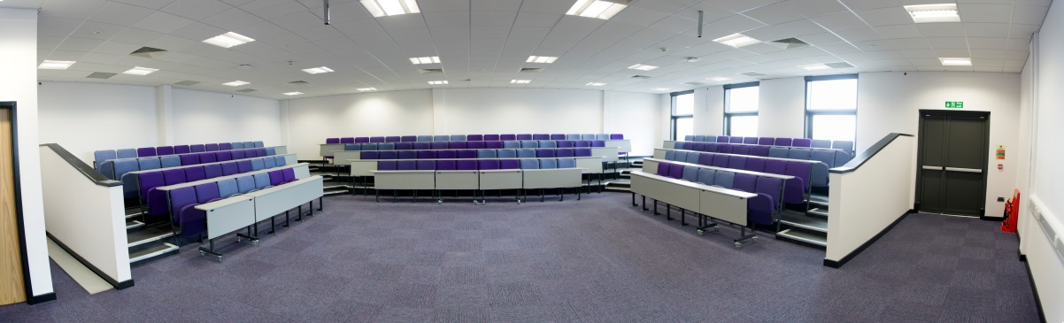



Bay Campus – School of Management

Slide 31
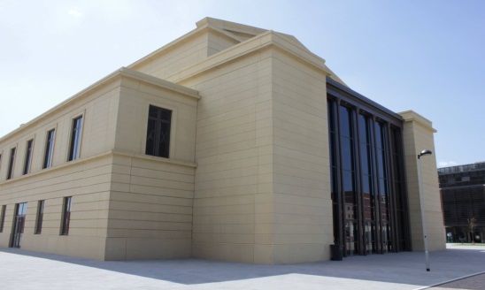
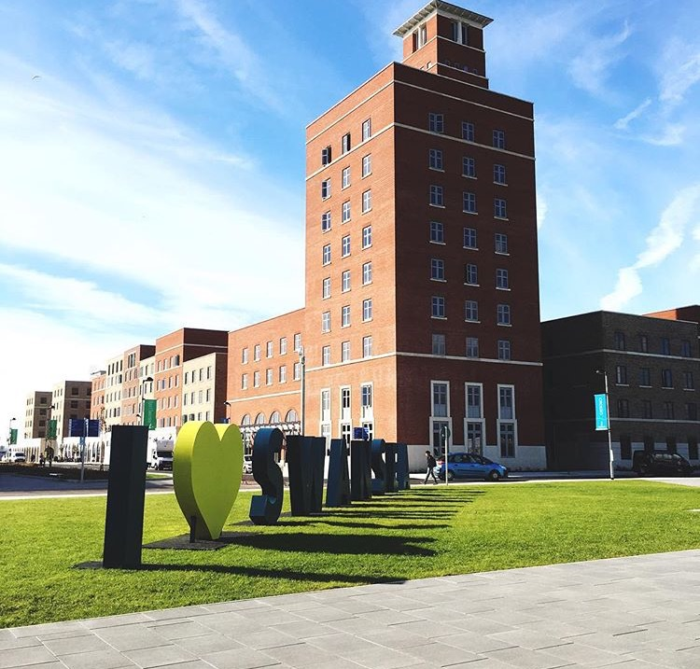
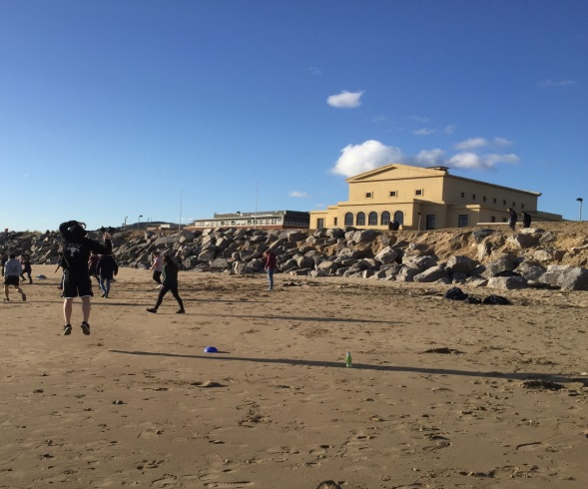
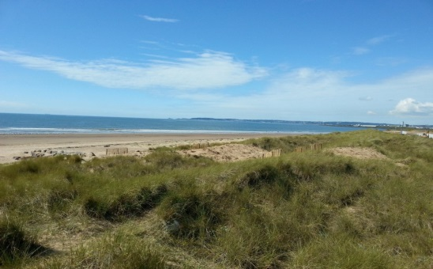
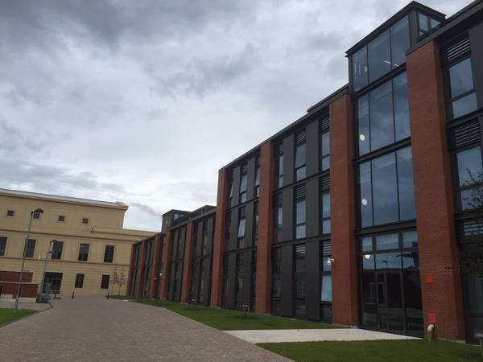
Bay Campus

Slide 32
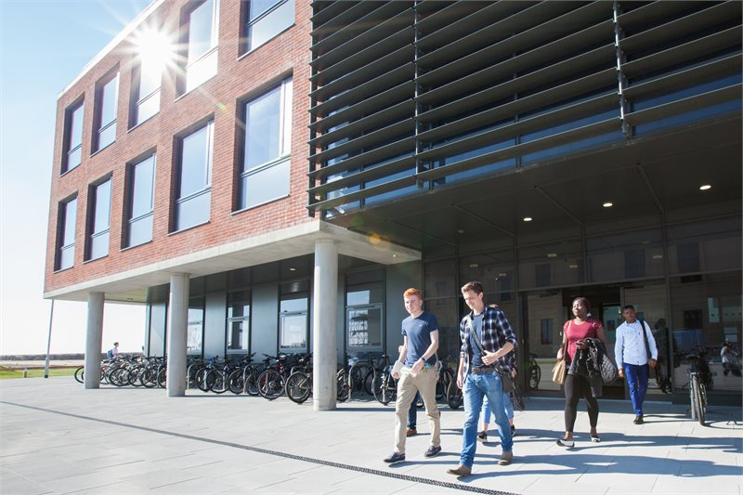


Get in touch:
School of Management
Swansea University
Bay Campus
Swansea
SA1 8EN
Tel: +44 (0)1792 295601
Email: SoM@swansea.ac.uk
www.swansea.ac.uk/SOM

